Slide 1

Single-crystal Bragg Peak Finding
Richard Waite
Oak Ridge Dev Meeting
Oct 23

Slide 2
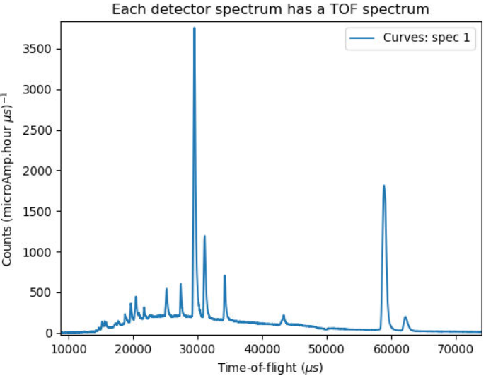
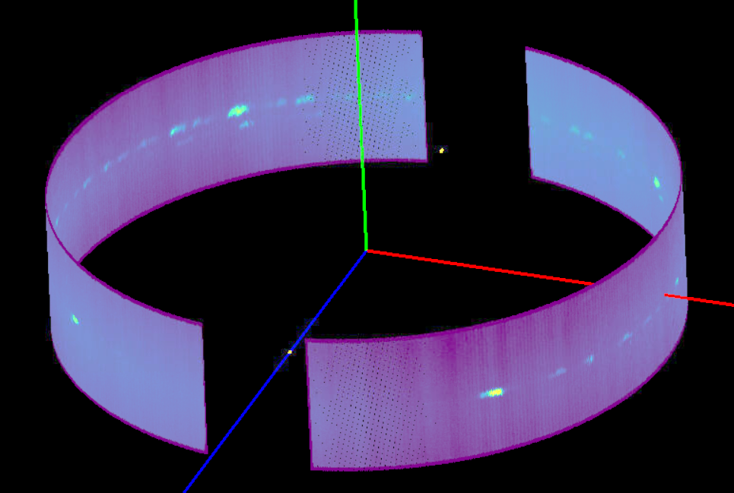
Why do it?
Finding peaks is the first step in any reduction
You need to find peaks to
Find a UB matrix to index peaks
Lattice parameters (B matrix)
Crystal orientation in lab frame (U Matrix)
Find satellite peaks to determine modulation vectors
Centering conditions
Calibrate the detector & sample positions

Slide 3
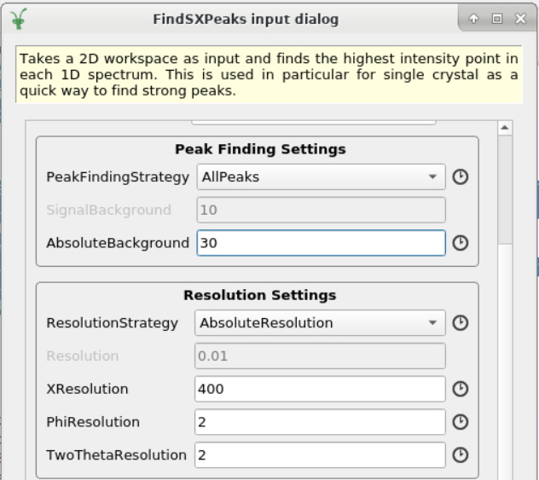
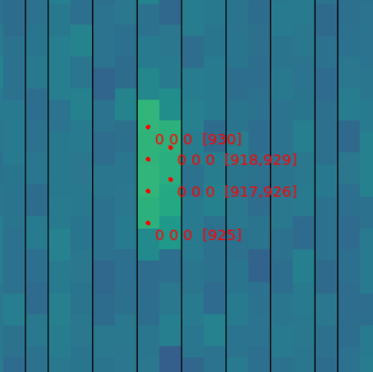
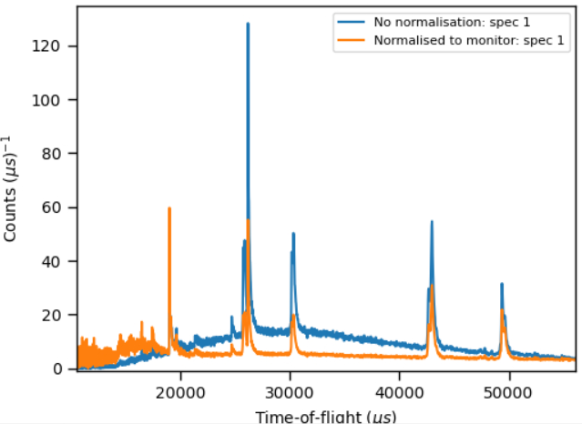
Currently in mantid
Two approaches:
Detector-TOF space (FindSXPeaks)

Slide 4
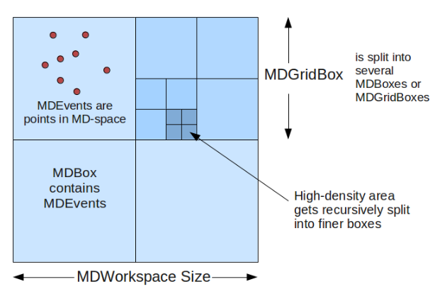
Currently in mantid
Two approaches:
Detector-TOF space
Q-space (FindPeaksMD)
Sort boxes by signal density above threshold
Add N peaks starting from densest boxes
Reject boxes too close to existing peaks

Slide 5
Currently in mantid
Methods share common disadvantages
Not good for weak peaks
Arbitrary threshold (needs to be optimised for each sample)
Not looking at peaks wrt to local background
Method | Pros | Cons
FindSXPeaks | Fast | Find peaks in powder lines Spurious peaks due to noise Using stats on a single pixel (misses weak peaks) Requires data to be normalised by monitor Not suited for strongly varying background Arbitrary cutoff
FindPeaksMD | Good at finding strong peaks | Need to convert data to Q Not designed to find weak peaks Requires data to be normalised by monitor Not suited for strongly varying background

Slide 6
A new approach needed
Requirements:
Find peaks in detector-TOF space
Takes into account local background (varies with scattering angle and wavelength)
Exclude powder lines → 3D peak finding!
Not as sensitive to noise → group detector pixels
Use knowledge of peak shape and resolution
TOF extent from back-to-back parameters
Constrain peak size on detector
Prefer some statistical threshold rather than arbitrary cut-off

Slide 7
A new algorithm FindSXPeaksConvolve
Inspired by traditional blob detection methods (Laplacian convolution, difference of Gaussians etc.) and 2D image plate integration methods in x-ray diffraction.
Convolves data (XY-TOF) in each RectangularDetector with 3D shoebox integration kernel (with background shell)
TOF extent from NFWHM of BackToBackExponential at center of detector and spectrum
XY hard-coded for now (could use different one per bank)
Finds contiguous bins with I/sigma > threshold
Reject peaks number of bins below fractional size (1/8) of kernel
Assigns peaks to highest counts in shoebox placed at largest I/sigma bin in each region

Slide 8
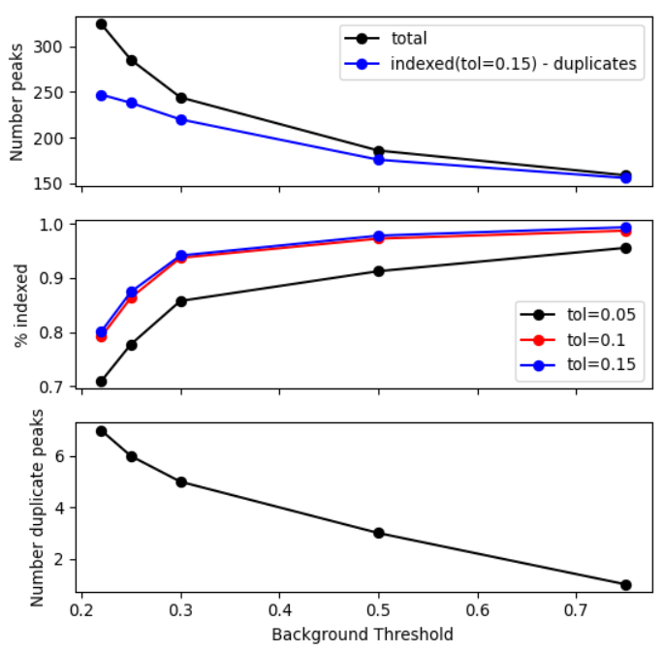
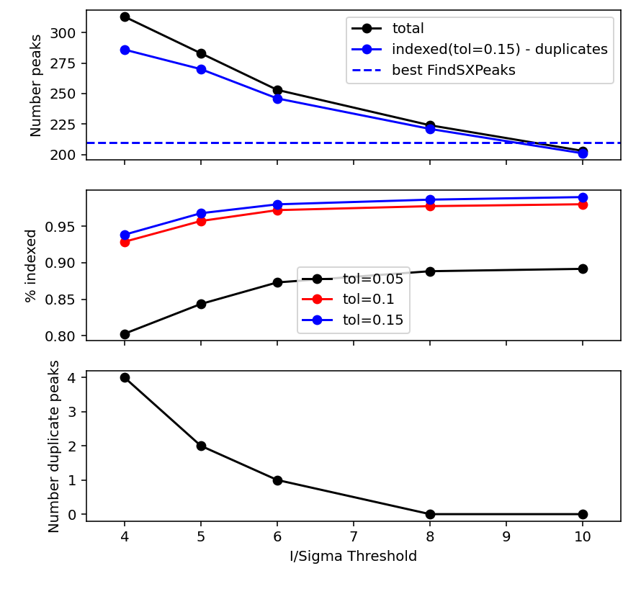
Comparison
FindSXPeaks
FindSXPeaksConvolve

Slide 9
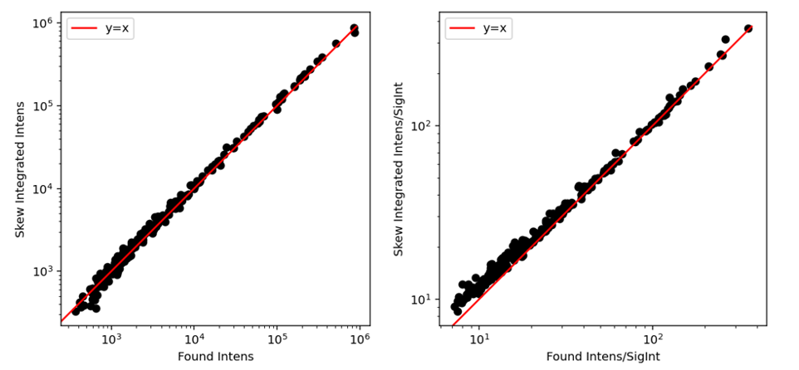
Performance of integration
Good agreement of intensity
Slightly underestimate I/sigma (especially weak peaks I/sigma < 10)
Possibly due to non-optimised shoebox size.

Slide 10
Next steps
Dynamic shoebox integration on predicted peak positions
Adjust peak size to maximise I/sigma?
How to resolve partially overlapping peaks?
Speed it up (currently in python…)

Slide 11
Thank you!

Slide 12
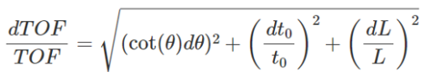
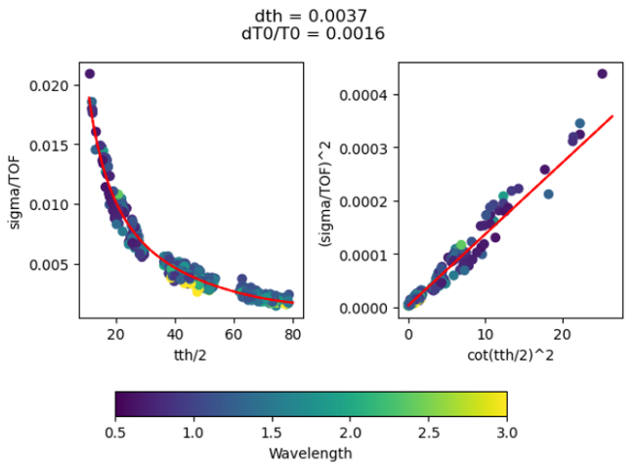
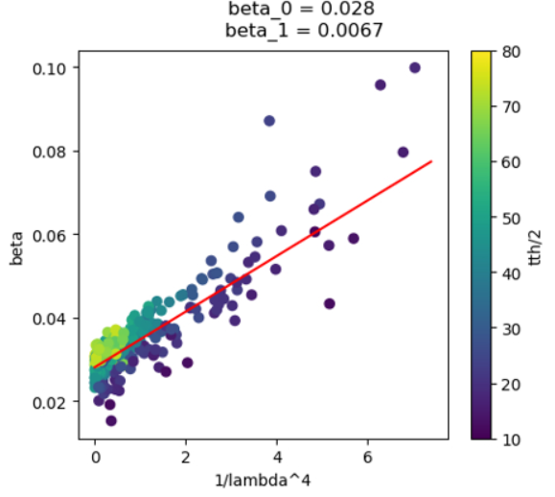
Finding good back-to-back parameters

